Slide 1
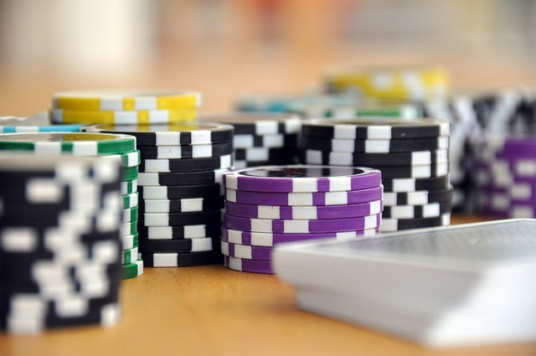
Project PHASE 2 Report JAAM studios presents… JAAM Casino BLACKJACK GOAT Phase 2

Slide 2
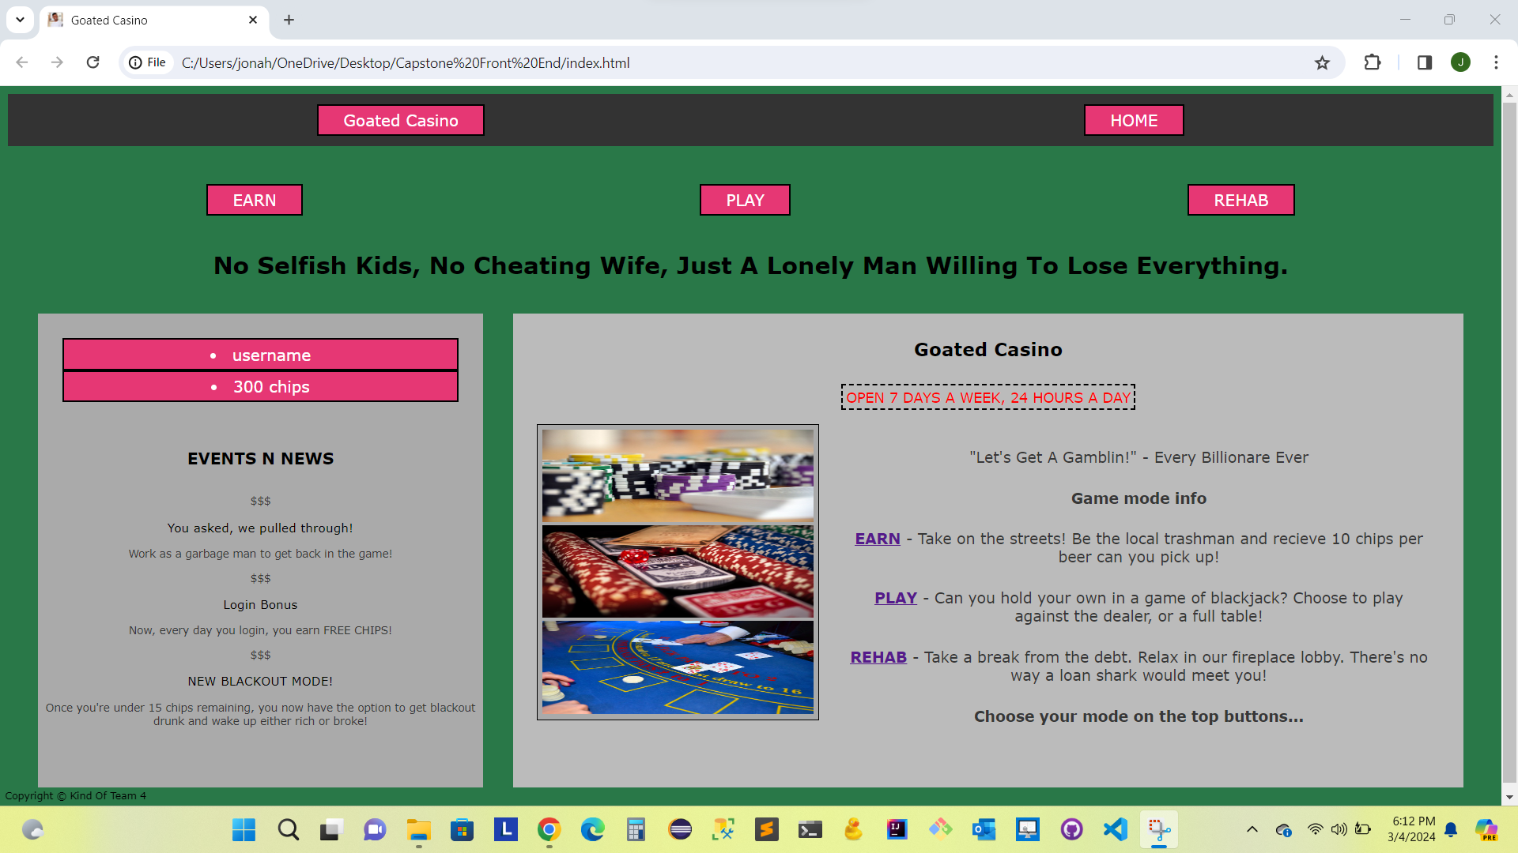
Homepage
- This is our Homepage featuring 5 buttons at the top for our different gameplay avenues or to return to home page
- On the left we have our news feed for updates and events
- On the right we have an explanation of each game mode

Slide 3
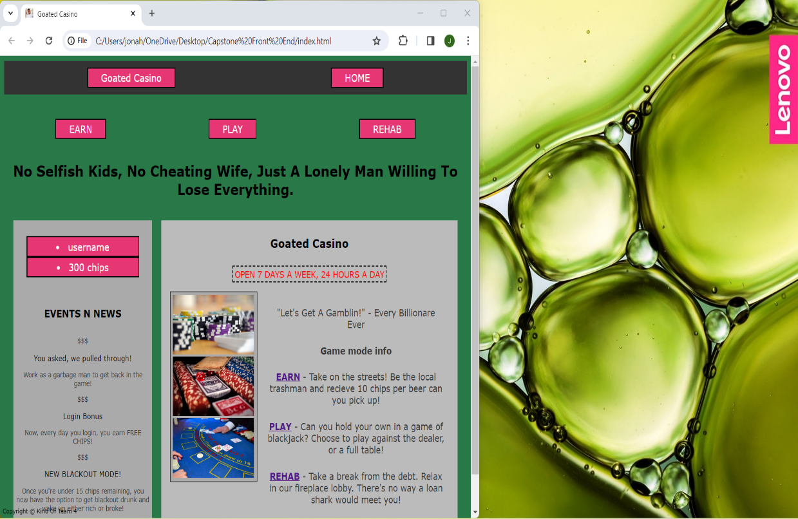
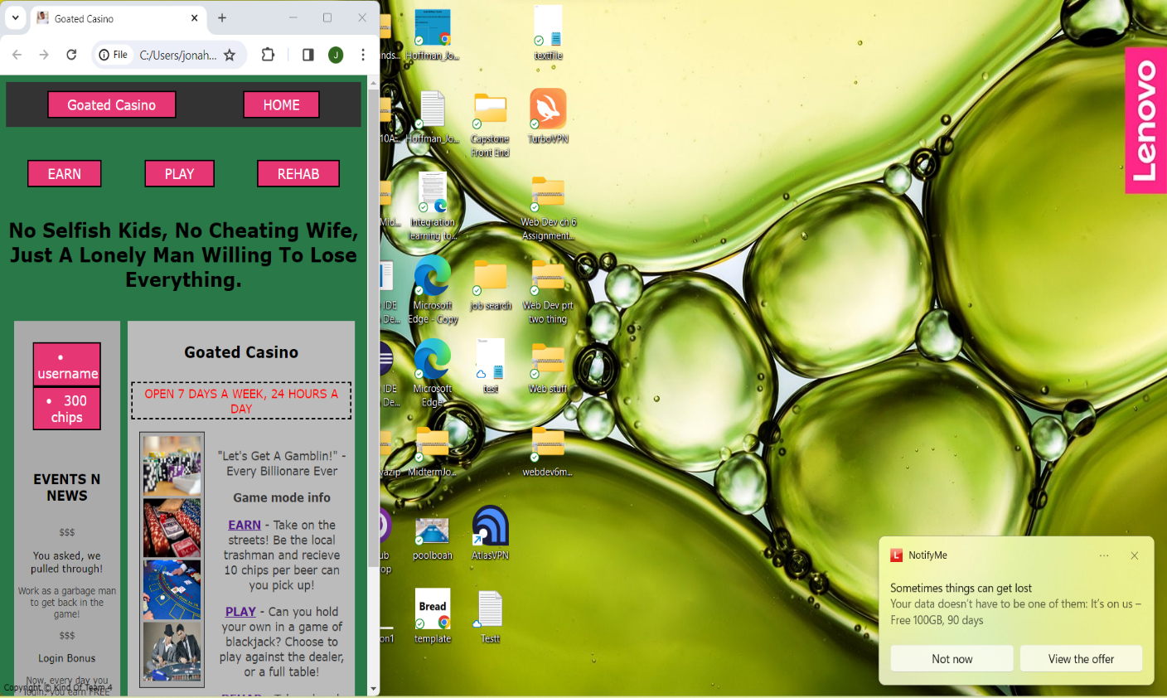
UI Scaling
- Here we are featuring the scalability of our homepage
- As you can see the homepage can be scaled to any size and still retain all its interactable buttons and all text
- Here the homepage is even further scaled, and you can see the user’s desktop in the background for comparison of size.
- As you can see the UI is still perfectly functional no matter the resolution of the webpage window.

Slide 4
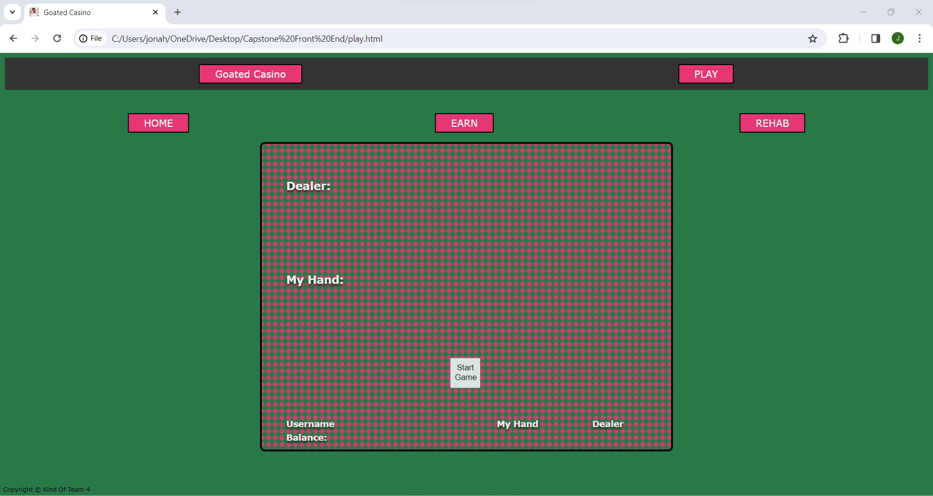
Fresh Game
- Here we have the UI that appears when ‘Play’ button is selected
- This is before cards are dealt
- In order to deal cards user must select ‘Start Game’ button in the center of the table
- We have not yet implemented customization of the table felt background this is to come in a future phase..

Slide 5
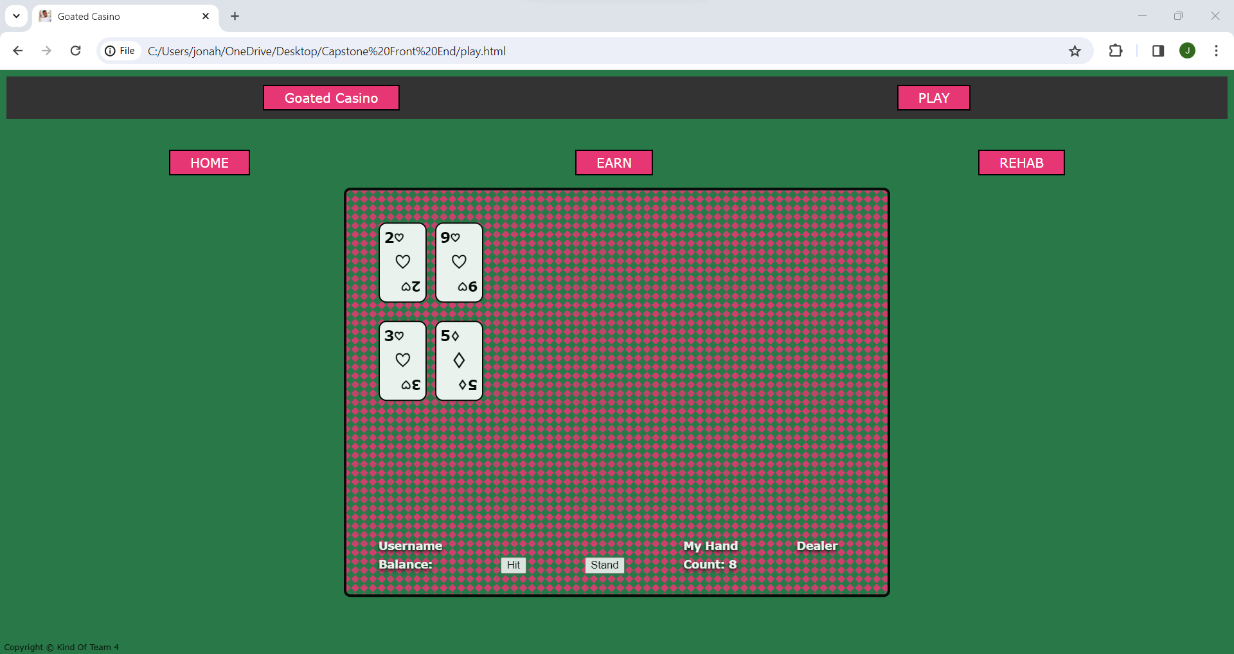
Cards Dealt
- This is the screen after clicking ‘Start Game’ in the center of the table
- You’ll notice two cards have been dealt to each the dealer and the user
- You will see your hand is then totaled in the bottom right of the UI and you are given two options to either ‘hit’ or ‘stand’
- Further implementation of ‘Double down’ or ‘Splitting’ pocket pairs is to come…

Slide 6
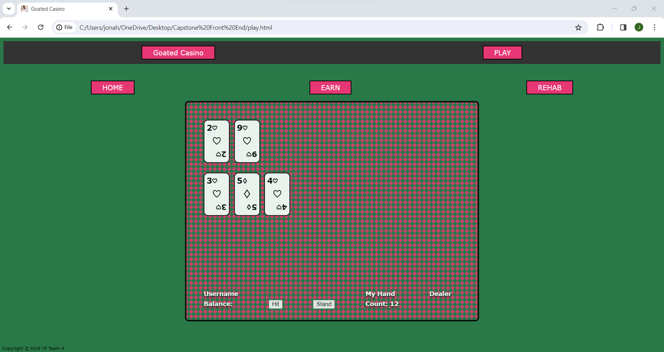
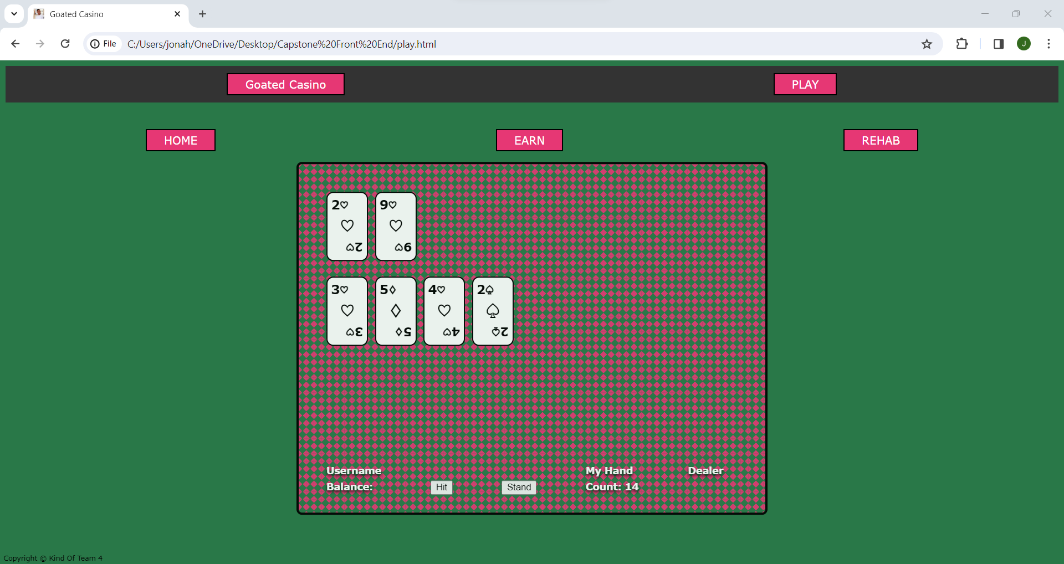
Selecting ‘Hit’
- After the user selects ‘Hit’ you can see another card is dealt to the user and your hand total is updated in the UI
*Notice all buttons are still accessible on the Page and at any moment user can exit and forfeit the hand*
More ‘Hits’
- The user then decides to ‘Hit’ again, is dealt another, and total is updated once more in the UI.
- The user is able to hit as many times as they’d like until they ‘Bust’ (hand total becomes 22 or more)

Slide 7
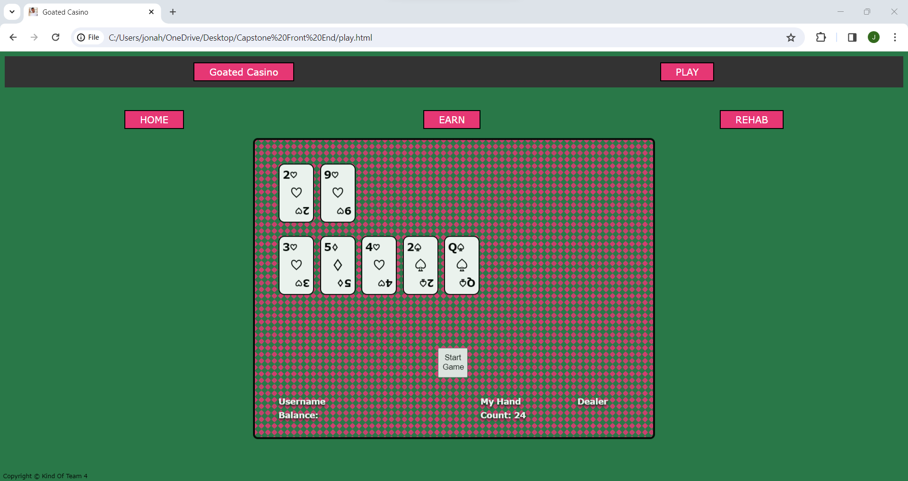
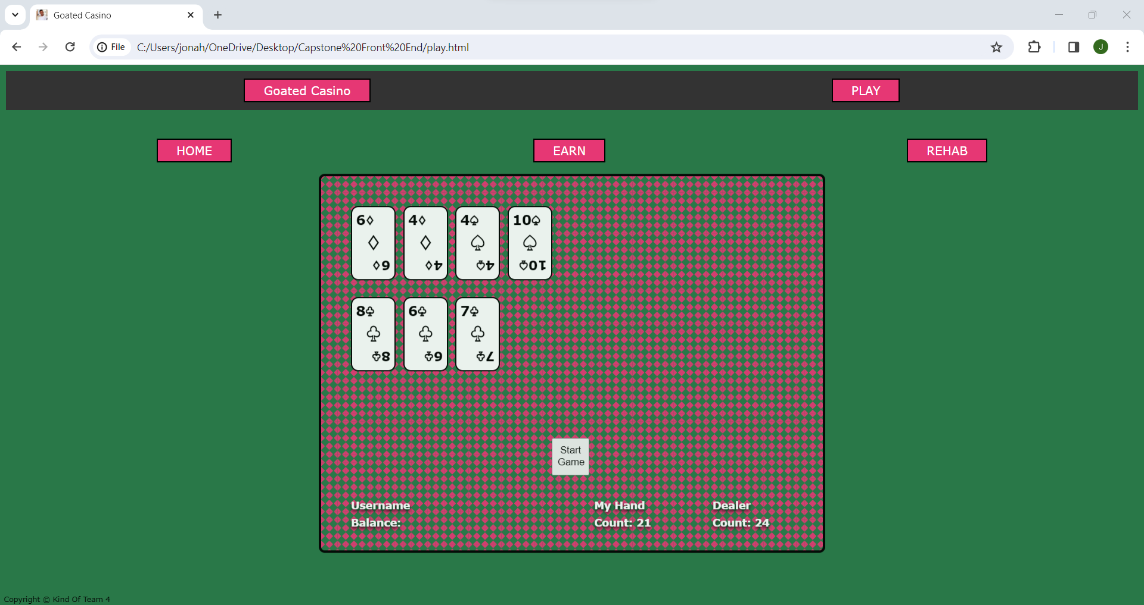
‘Bust’ Example
- In this screenshot you see an example of the user’s hand exceeding 21 which will result in a ‘Bust’ or loss..
- Further implementation of a visual that shows the user has ‘Bust’ to come…
‘Win’ Example
- However, in this screenshot you will see the user has won
- The user has received 21 as their hand total and the dealer has gone ‘Bust’ with a 24-hand total
- Further implementation of a visual representation of this to come as well…

Slide 8
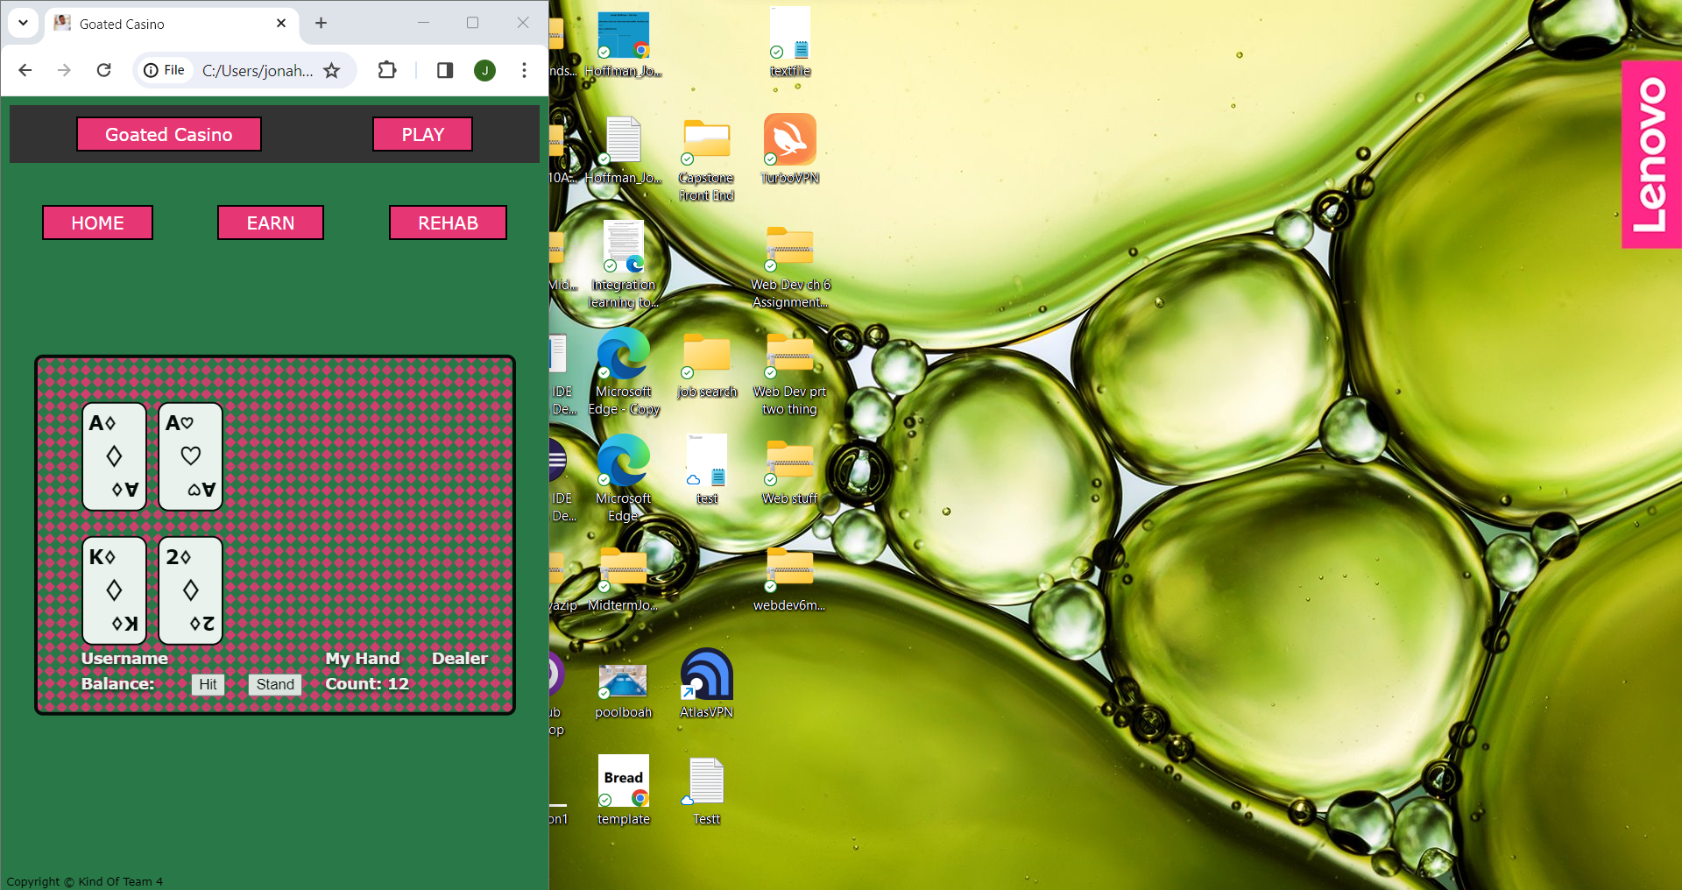
- In this screenshot we show that even during blackjack gameplay the window is still scalable to any size
- Scaling the window to your liking will not result in any loss of functionality as all assets and gameplay features will still be visible
- You can see the user’s desktop in the background for confirmation of this scalability

Slide 9
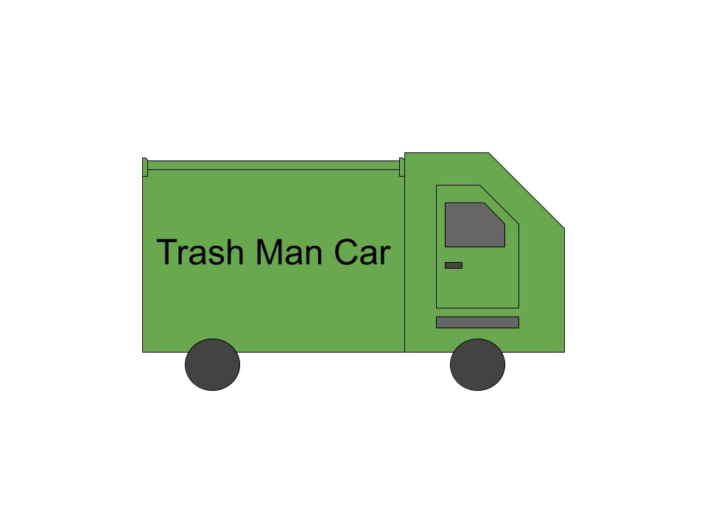
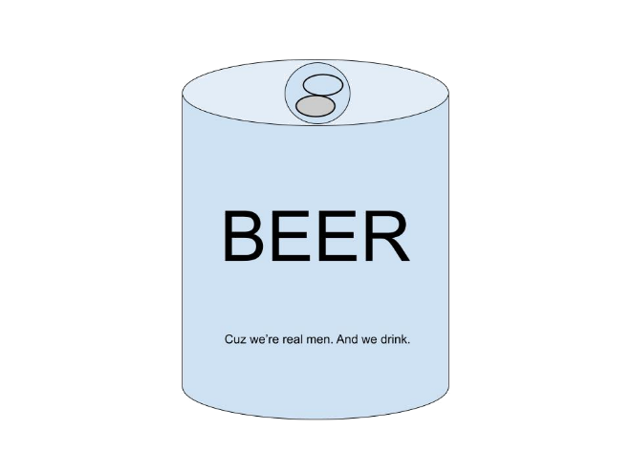
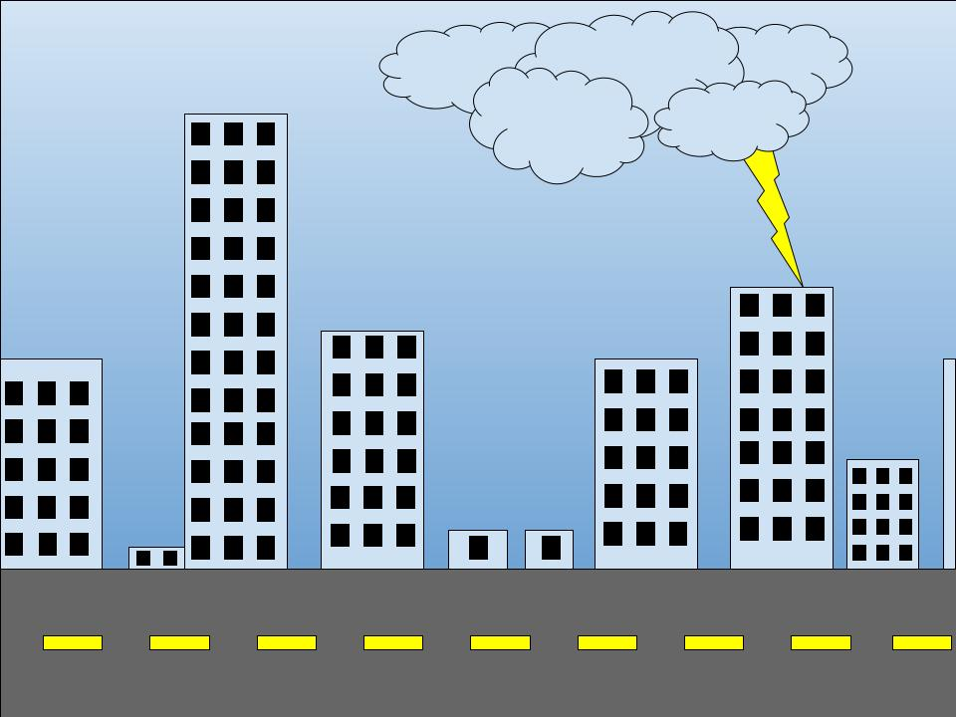
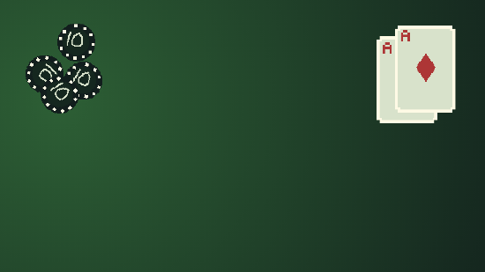
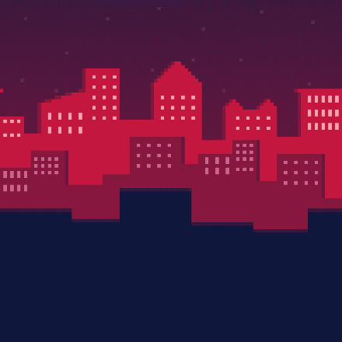
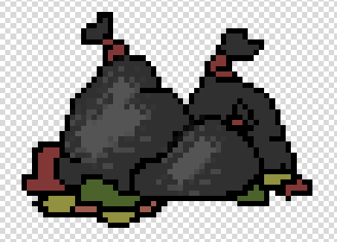
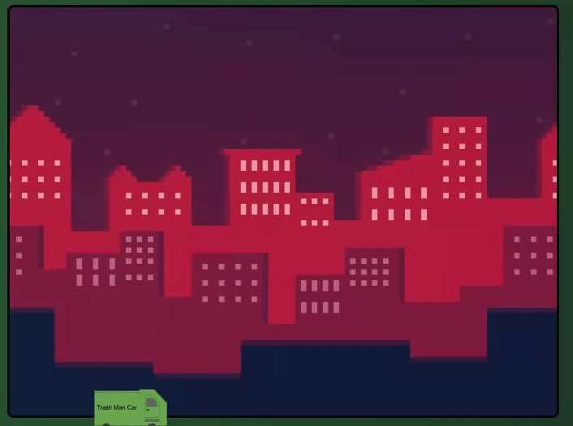
Assets
- This page displays our currently custom created assets that will be used
- 2 different background choices for ‘earn’ gameplay
- A different possible table background
- A beer can and trash bag asset to be used during ‘Earn’ gameplay
- The trash car you drive during ‘earn’ gameplay

Slide 10
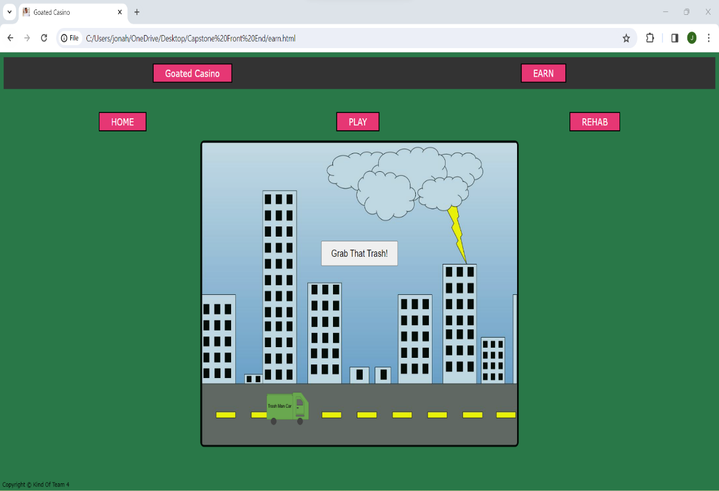
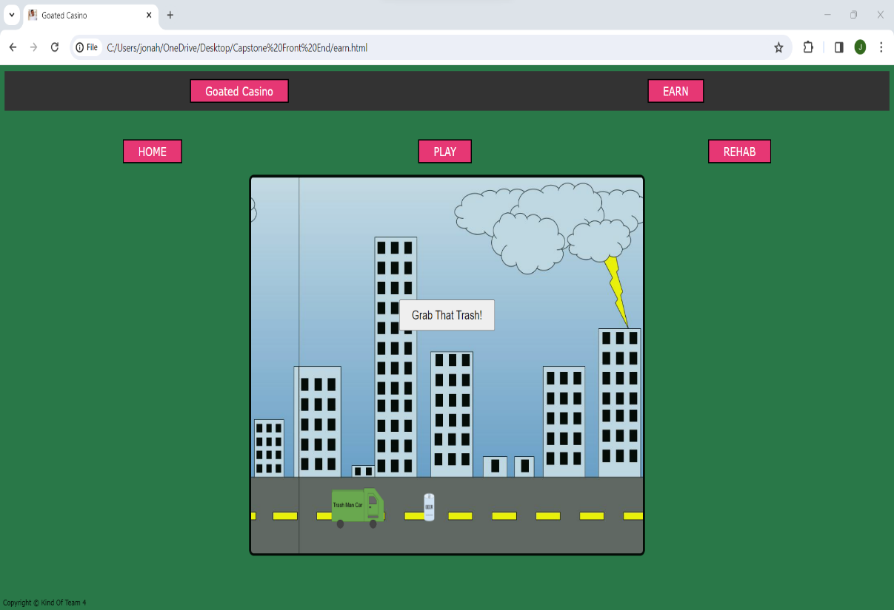
‘Earn’ Gameplay
- Here you see our ‘Earn’ gameplay start screen with and without the beer can asset to pickup
- ‘Earn’ gameplay is an available gameplay option for users who are running low on chips and want to earn more via working as a trash collector
- User can enjoy cleaning the streets as the background scrolls and trash appears on the road
- We currently have two background choices for this ‘earn’ gameplay and more assets are being developed to use as trash
- Amount earned via trash pickup is still being determined and will be announced in a future phase…

Slide 11
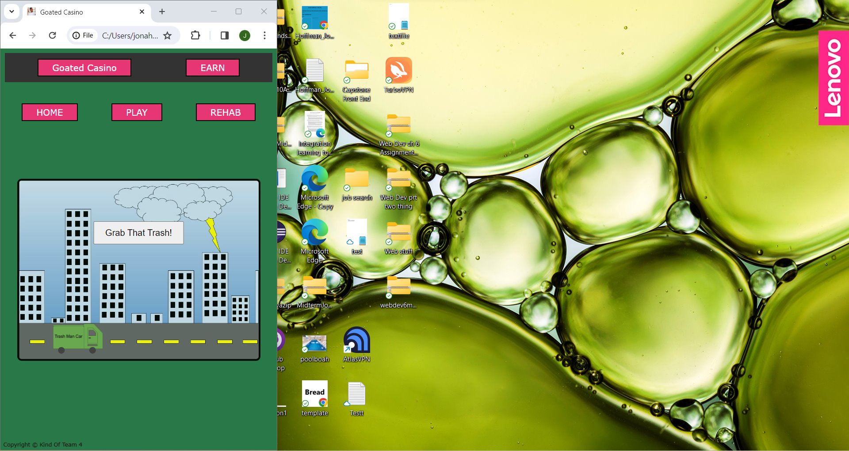
More UI Scaling Functionality
- As you can see our entire web application is UI scalable
- This is further displayed here with our ‘Earn’ gameplay
- All UI buttons at the top of the screen as well as the entire gameplay screen are still visible regardless of window sizing
- This is once again shown in relation to a user desktop background to express how UI friendly our application is!

Slide 12
Thanks Again Shareholders!
We look forward to seeing you in Phase 3 to show some back end and further front-end development.

